Slide 1
Fresh Grads – Group Project
Online Job Portal

Slide 2
Problem Statement
Tasks Required in hire freelancer application
1) Recruiters should be able to post jobs
2) Recruiters should be able to search and bookmark freelancers
3) Recruiter can award the job to a freelancer
4) Recruiter can rate and provide a feedback for freelancer who has completed
the job for recruiter
5) Freelancers can search and apply for the jobs with a cover letter
6) Freelancers can look at all the previously applied applied
7) Freelancers can search and bookmark the jobs
8) Recruiters can bookmark freelancers for a particular skill

Slide 3
Road Map
Application will be developed in following Sprints –
Core Java +JPA with Hibernate
Spring Boot + Rest Controller + JPA with Hibernate
Angular for UI design (Front End) + Integration with previous Sprint

Slide 4
Plan
Design
Generate the skeleton as per class design provided
TDD approach
Identify test cases for each module
Write Failing Test cases
Convert the Test Cases in GREEN
Implement the case study in incremental manner

Slide 5
Modules
Login Module
Admin
Module
Recruiter Module
Freelancer Management
Module
Skill Management Module
Job Module
BookMark Job Module
Job Application
Module
Feedback Module

Slide 6
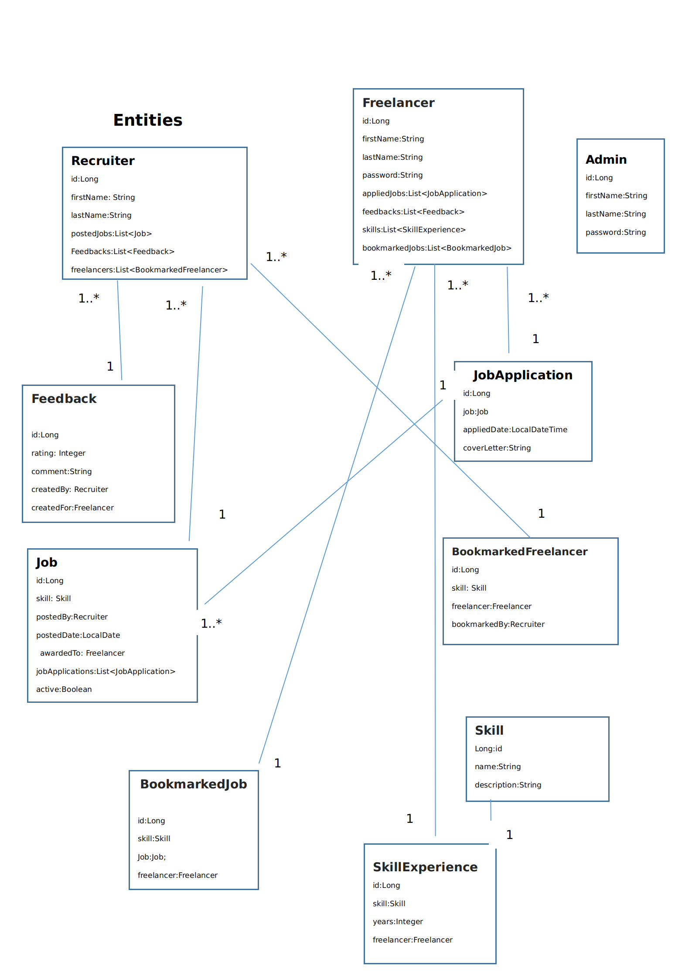
Class Design
POJO Classes:

Slide 7
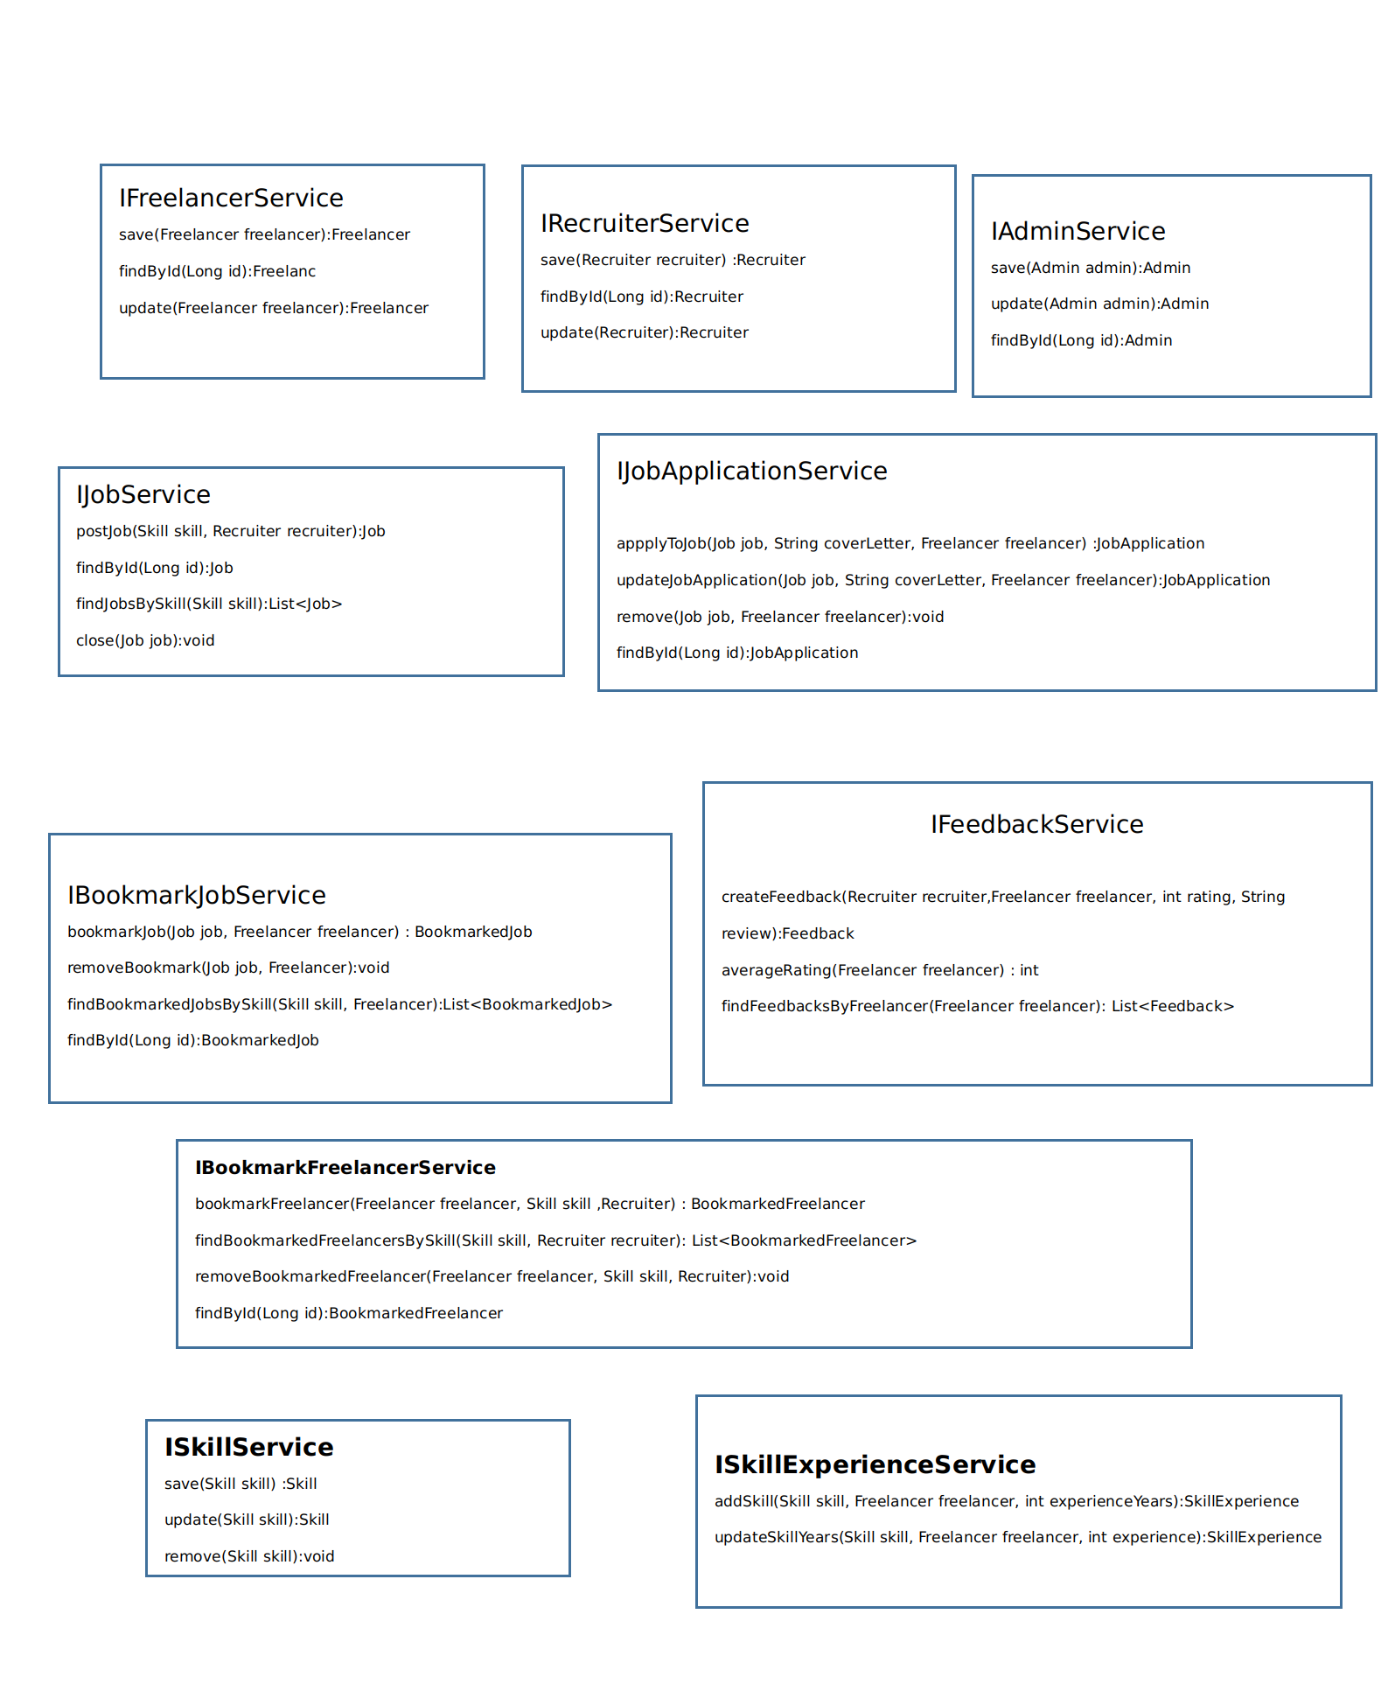
Class Design
Service Interface:

Slide 8
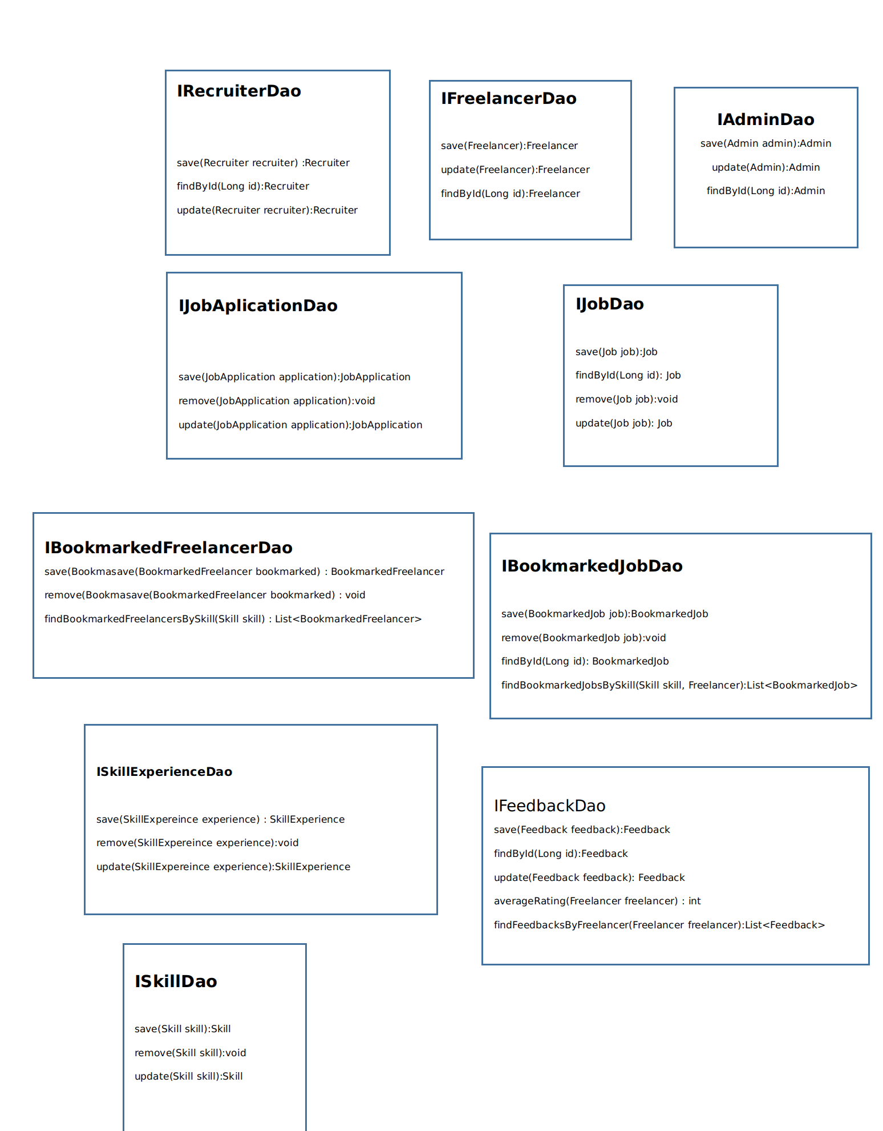
Class Design
Repository:

Slide 9




Questions

